Slide 1

SRM INSTITUTE OF SCIENCE AND TECHNOLOGY
Ramapuram, Chennai – 600 089
SCHOOL OF COMPUTER SCIENCE AND ENGINEERING DEPARTMENT OF COMPUTER SCIENCE AND ENGINEERING
21CSC305P - Machine Learning
First Review
Toxic Language Detection and Content Filtering
Team Members | Supervisor
VILASNI M (RA2311003020003) MOHAMED SHAKEEL M S (RA2311003020012) HARIHARAN S (RA2311003020022) TAMIZHSELAN A(RA2311003020042) | Dr. Adlene Ebenezer P, Assistant Professor, SRM IST, Ramapuram.

Slide 2

INTRODUCTION
Toxic Language Detection & Content Filtering
Online platforms like YouTube, Instagram, and Twitter face rising toxic and abusive comments.
Our system automatically detects and blurs offensive content in real-time.
Ensures user safety while maintaining context, promoting a safer and inclusive online environment.

Slide 3
EXISTIN PROBLEM STATEMENT
Perspective API
How it works: Sends user comments to Google’s API for toxicity scoring.
Drawbacks: Needs each comment to be sent individually → not fully real-time;
requires internet connection.
IBM MAX Toxic Comment Classifier
How it works: Cloud ML model analyses submitted text for abusive content.
Drawbacks: Sensitive user data sent externally → privacy concerns.
Roblox SentinelHow it works: Monitors all user messages (chats, posts) for inappropriate content.
Drawbacks: Scans all text, not just comments → intrusive, impacts privacy.

Slide 4

OBJECTIVE
Detect toxic and abusive comments automatically in online platforms.
Blur or hide offensive content to improve user experience and digital safety.
Provide a real-time, privacy-preserving solution without sending user data to external servers.
Create a lightweight, efficient system that can be integrated with any website or social media platform.

Slide 5
LITERATURE SURVEY PAPER 1
PAPER TITLE | PUBLISHED YEAR | METHADOLOGY USED | INTERFACE /REMARK
Hydrangea@DravidianLangTech2025: Abusive language Identification from Tamil and Malayalam Text using Transformer Models | 2025 | Fine-tune transformer models (BERT, XLM-RoBERTa, DistilBERT) on YouTube comments in Tamil & Malayalam. | XLM-RoBERTa gave the best F1 in both languages. DistilBERT worked well for Tamil but dropped significantly for Malayalam (low-resource setting). Shows that multilingual pre-training helps

Slide 6
LITERATURE SURVEY PAPER 2
PAPER TITLE | PUBLISHED YEAR | METHADOLOGY USED | INTERFACE /REMARK
A Text-to-Text Model for Multilingual Offensive Language Identification | 2023 | Use text-to-text transformer models (T5, mT5) trained on multiple offensive language datasets (SOLID, CCTK), combining datasets for multilingual offensive/hate/offensive content detection | The T5-based models outperform many encoder-only transformers. The multilingual version (mT5) performs very well across several languages, showing that multilingual models generalize better.

Slide 7
LITERATURE SURVEY PAPER 3
PAPER TITLE | PUBLISHED YEAR | METHADOLOGY USED | INTERFACE /REMARK
BanglaHateBERT: BERT for Abusive Language Detection in Bengali | 2022 | Retrain (fine tune) a BERT variant for Bengali using a large corpus of Bengali hateful/abusive posts, balanced hate-speech annotations, etc. Comparison vs generic BERT. | BanglaHateBERT outperforms generic pre-trained BERT in Bengali abusive detection tasks. Important example of how retraining on language-specific abusive content improves performance in non-English or low-resource settings.

Slide 8
LITERATURE SURVEY PAPER 4
PAPER TITLE | PUBLISHED YEAR | METHADOLOGY USED | INTERFACE /REMARK
Efficient Toxic Content Detection by Bootstrapping and Distilling Large Language Models | 2023 | Bootstraps large language models (LLMs) and distills them into smaller student models; uses a prompting method called Decision-Tree-of-Thought (DToT) and fine-tunes student models with rationales extracted from LLMs. | The distilled student models are much smaller and faster but still maintain strong accuracy and cross-dataset performance. Good example for how to make a lightweight model for toxicity detection.

Slide 9
LITERATURE SURVEY PAPER 5
PAPER TITLE | PUBLISHED YEAR | METHADOLOGY USED | INTERFACE /REMARK
CNLP-NITS-PP at GenAI Detection Task 3: Cross-Domain Machine-Generated Text Detection Using DistilBERT Techniques | 2025 | Fine-tuned DistilBERT for the task of detecting machine-generated text; addresses adversarial strategies (paraphrasing, misspellings, etc.) with cross-domain data training. | Shows DistilBERT is capable of performing well even when text is adversarial or from different domains. Useful for your project if comments also come from diverse sources.

Slide 10
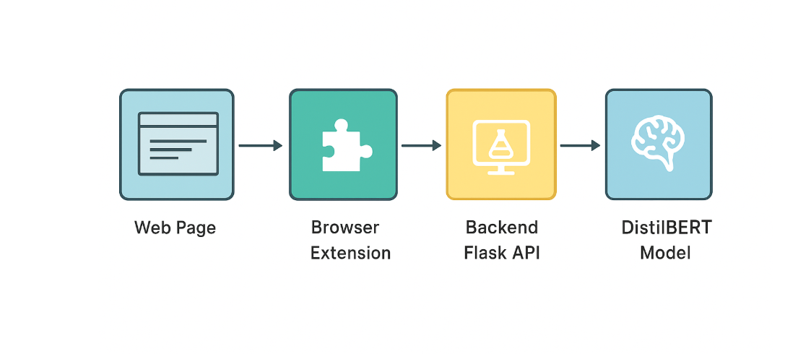
ARCHITECTURE DIAGRAM

Slide 11

MODULE DESCRIPTION
Module 1: Data Collection
Description:
Gather text data containing toxic, abusive, or offensive comments from publicly available datasets.
Prepare training and testing data in CSV format for the model.
Ensure data is cleaned, labeled, and representative of different types of abusive language.

Slide 12
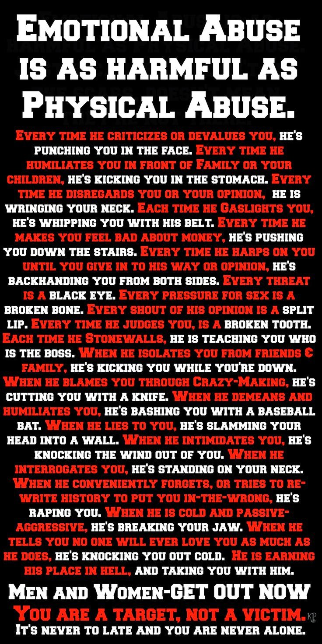
MODULE DESCRIPTION
Module 2: Model Training
Description:
Train a machine learning model using DistilBERT for toxic comment detection.
Use tokenization and self-attention mechanisms to understand the context and meaning of text.
Optimize the model for high accuracy, precision, and recall on detecting abusive comments.

Slide 13

MODULE DESCRIPTION
Module 3: Backend API
Description:
Develop a Flask API to serve the trained model.
Accept text input from front-end or extension and return predictions in real-time.
Enable local processing to maintain privacy and efficiency.

Slide 14

MODULE DESCRIPTION
Module 4: Browser Extension
Description:
Create a Chrome/Edge extension to integrate the detection system with websites.
Automatically scan comments on a page and blur abusive content.
Provide a toggle button to unblur content if needed.

Slide 15

MODULE DESCRIPTION
Module 5: Real-time Comment Filtering
Description:
Combine the trained model, backend API, and extension for live usage.
Ensure the system works seamlessly on platforms like YouTube or Instagram.
Provide users with a safer browsing experience without disrupting normal interaction.

